Slide 1
2019 CIDD COMMUNITY TALK SERIES
Addressing the Sexual Violence Epidemic in the IDD Community
Margaret DeRamus, MS, CCC-SLP
Morgan Parlier, MSW, LCSW
Deb Zuver, MA, LMFT, RDT
Notes:
Morgan

Slide 2
Objectives
Increase understanding of sexual violence issue in the DD community
Review best practices/promising practices that support prevention, intervention, and recovery
Identify resources such as community options and training for individuals, families, and professionals that focus on healthy sexuality and support survivors of sexual violence with DD
Learn specific strategies for reducing the risk of sexual violence for individuals with I/DD

Slide 3
What Constitutes Sexual Violence?
Sexual Violence is defined by CDC as a sexual act committed against someone without that person’s freely given consent.
  Rape, sexual assault, sex trafficking, groping, stalking, sexual harassment, sexual coercion
Sexual Abuse - Undesired, non-consensual sexual contact in the form of coercion, exploitation, rape and assault
Notes:
Morgan
Sexual violence encompasses a variety of criminal acts—from sexual threats to unwanted contact to rape. Sexual violence is pervasive and often traumatizing to its victims. For a number of reasons, however, including the stigma and insensitive treatment often associated with these crimes, sexual violence remains highly underreported. Sexual violence is also a difficult concept to measure, primarily due to: inconsistent definitions of sexual assault and rape; differing reporting requirements across local, state, and national law enforcement; and low conviction rates. While people of all genders and gender identities are victims of sexual violence, the majority of these acts are perpetrated by male offenders against female victims. Most victims know the perpetrator in some capacity, either as a friend, acquaintance, family member, or intimate partner. For more information, see the Campus Victimization fact sheet in this series From NSVRC 2018 Sexual Violence Resource Guide
Sexual violence is divided into the following types:
Sexual violence – umbrella term – rape, sexual assault, sex trafficking, groping, stalking, sexual harassment, sexual coercion
Completed or attempted forced penetration of a victim
Completed or attempted alcohol/drug-facilitated penetration of a victim
Completed or attempted forced acts in which a victim is made to penetrate a perpetrator or someone else
Completed or attempted alcohol/drug-facilitated acts in which a victim is made to penetrate a perpetrator or someone else
Non-physically forced penetration which occurs after a person is pressured verbally or through intimidation or misuse of authority to consent or acquiesce
Unwanted sexual contact
Non-contact unwanted sexual experiences
Completed or attempted forced penetration of a victim ─ includes completed or attempted unwanted vaginal (for women), oral, or anal insertion through use of physical force or threats to bring physical harm toward or against the victim. Examples include
Pinning the victim’s arms
Using one’s body weight to prevent movement or escape
Use of a weapon or threats of weapon use
Assaulting the victim
Completed or attempted alcohol or drug-facilitated penetration of a victim ─ includes completed or attempted unwanted vaginal (for women), oral, or anal insertion when the victim was unable to consent because he or she was too intoxicated (e.g., incapacitation, lack of consciousness, or lack of awareness) through voluntary or involuntary use of alcohol or drugs.
Completed or attempted forced acts in which a victim is made to penetrate a perpetrator or someone else ─ includes situations when the victim was made, or there was an attempt to make the victim, sexually penetrate a perpetrator or someone else without the victim’s consent because the victim was physically forced or threatened with physical harm. Examples include
Pinning the victim’s arms
Using one’s body weight to prevent movement or escape
Use of a weapon or threats of weapon use
Assaulting the victim
Completed or attempted alcohol or drug-facilitated acts in which a victim is made to penetrate a perpetrator or someone else ─ includes situations when the victim was made, or there was an attempt to make the victim, sexually penetrate a perpetrator or someone else without the victim’s consent because the victim was unable to consent because he or she was too intoxicated (e.g., incapacitation, lack of consciousness, or lack of awareness) through voluntary or involuntary use of alcohol or drugs.
Nonphysically forced penetration which occurs after a person is pressured verbally, or through intimidation or misuse of authority, to consent or submit to being penetrated – examples include being worn down by someone who repeatedly asked for sex or showed they were unhappy; feeling pressured by being lied to, or being told promises that were untrue; having someone threaten to end a relationship or spread rumors; and sexual pressure by use of influence or authority.
Unwanted sexual contact – intentional touching, either directly or through the clothing, of the genitalia, anus, groin, breast, inner thigh, or buttocks of any person without his or her consent, or of a person who is unable to consent or refuse. Unwanted sexual contact can be perpetrated against a person or by making a person touch the perpetrator. Unwanted sexual contact could be referred to as “sexual harassment” in some contexts, such as a school or workplace.
Noncontact unwanted sexual experiences – does not include physical contact of a sexual nature between the perpetrator and the victim. This occurs against a person without his or her consent, or against a person who is unable to consent or refuse. Some acts of non-contact unwanted sexual experiences occur without the victim’s knowledge. This type of sexual violence can occur in many different settings, such as school, the workplace, in public, or through technology. Examples include unwanted exposure to pornography or verbal sexual harassment (e.g., making sexual comments).
Why Is a Consistent Definition Important?
A consistent definition is needed to monitor the prevalence of sexual violence and examine trends over time. In addition, a consistent definition helps in determining the magnitude of sexual violence and aids in comparing the problem across jurisdictions. Consistency allows researchers to measure risk and protective factors for victimization and perpetration in a uniform manner. This ultimately informs prevention and intervention efforts.
Reference

Slide 4
Sexual Violence in the US
Every 98 seconds, an American is sexually assaulted
And every 11 minutes, that victim is a child
Meanwhile, only 5 out of every 1,000 perpetrators will end up in prison
Notes:
Morgan
To research your local laws: https://www.rainn.org/laws-your-state-north-carolina

Slide 5
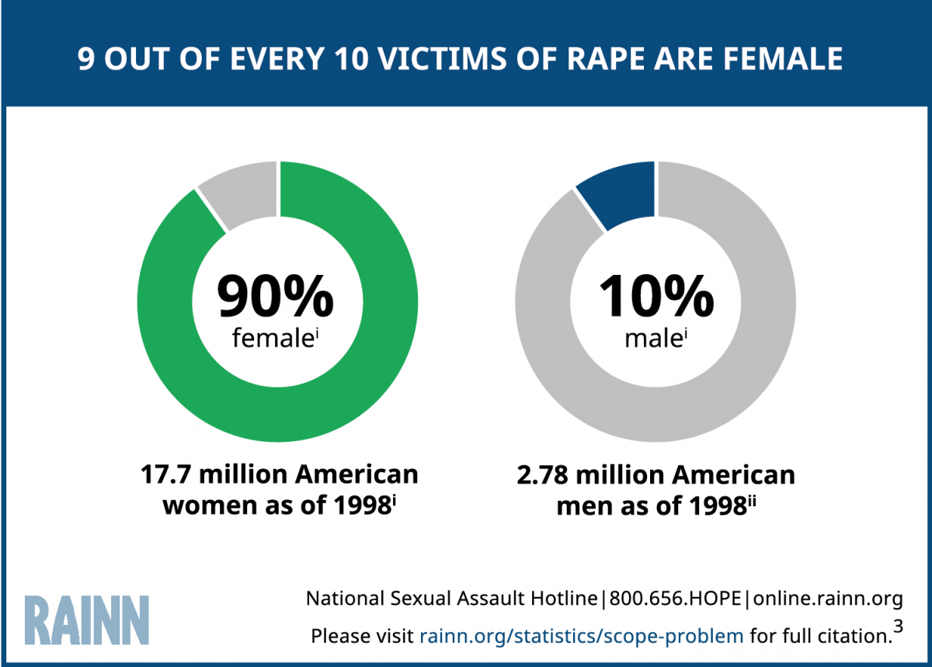
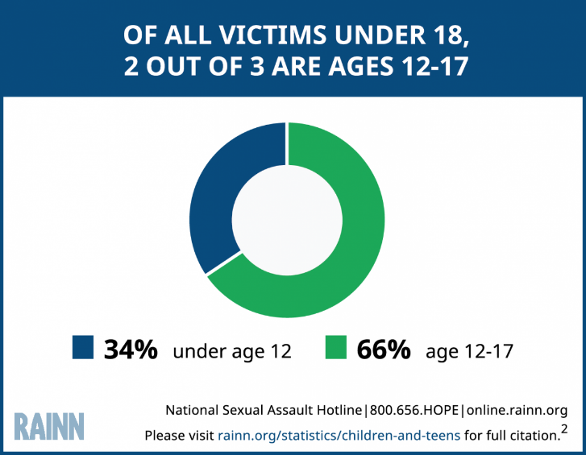
Impacts Everyone
1 out of every 6 American women has been the victim of an attempted or completed rape in her lifetime
About 3% of American men—or 1 in 33—have experienced an attempted or completed rape in their lifetime
From 2009-2013, CPS agencies substantiated, or found strong evidence to indicate that, 63,000 children a year were victims of sexual abuse
Notes:
Morgan

Slide 6
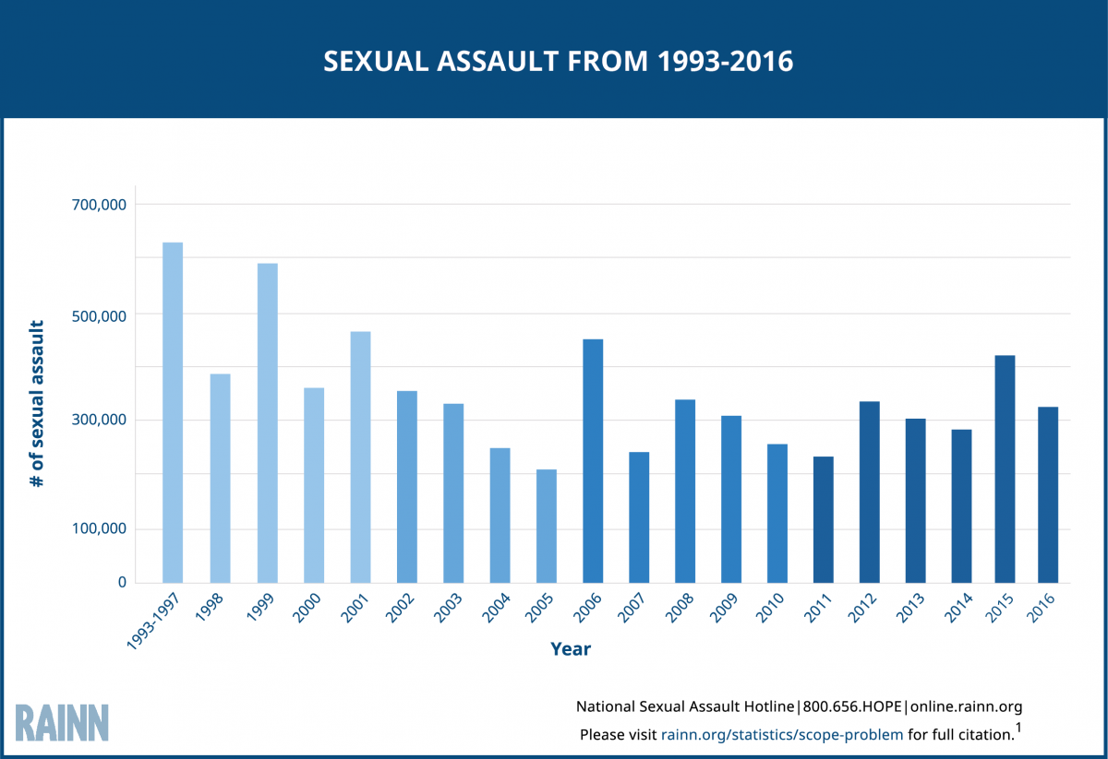
Trending Downward
Between 1993 and 2016, the rate of sexual assault and rape in the US has fallen 63%
Notes:
Morgan
The rate of sexual assault and rape has fallen 63% since 1993, from a rate of 4.3 assaults per 1,000 people in 1993, to 1.2 per 1000 in 2016.¹
RAINN (Rape, Abuse & Incest National Network) is the nation's largest anti-sexual violence organization. RAINN created and operates the National Sexual Assault Hotline (800.656.HOPE, online.rainn.org y rainn.org/es) in partnership with more than 1,000 local sexual assault service providers across the country and operates the DoD Safe Helpline for the Department of Defense. RAINN also carries out programs to prevent sexual violence, help survivors, and ensure that perpetrators are brought to justice.

Slide 7
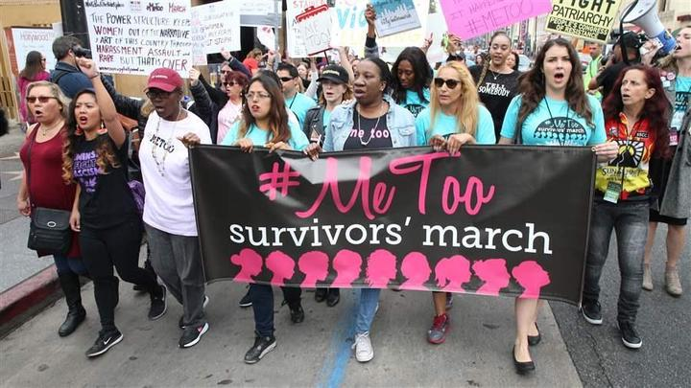
Growing Public Awareness of Sexual Violence
Me Too Movement
Times Up
Epstein Case
US Supreme court confirmation of Brett Kavanaugh
Sexual Assault Case by Healthcare worker in AZ
Notes:
Morgan
Sexual Harassment in the work place
Gender Discrimination
Licensed nurse in Arizona working at a nursing care facility Hacienda Healthcare who sexually assaulted a woman who had a pronounced TBI from age 3 who gave birth without anyone ever recognizing she was pregnant.
Hacienda Healthcare describes itself as the leading provider of specialized medical services for fragile and chronically ill infants, children, teens, and young adults as well as those with I/DD

Slide 8
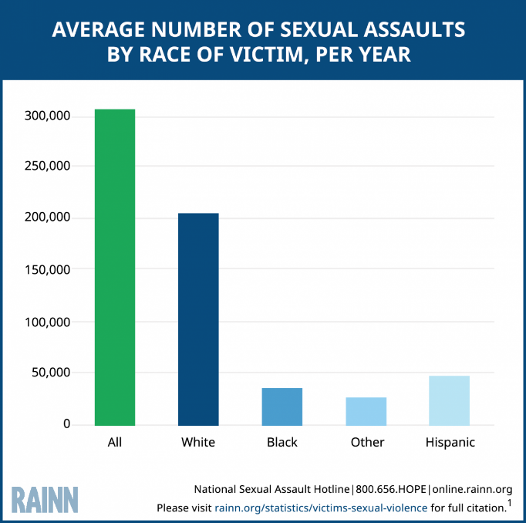
Disproportionate Representation
Younger people
Women
Native Americans
People with Disabilities
Transgender people
Notes:
Deb
People 34 and younger are at higher risk - If you are involved in the lives of adolescents, you can learn to recognize warning signs that a teen has been sexually assaulted or abused. Studies show that ages 12-34 are the highest risk years for crimes of sexual violence, and that females ages 16-19 are four times more likely than the general population to be victims of these crimes.¹ If you can learn how to spot sexual assault or abuse, you can do something to help.
On average, American Indians ages 12 and older experience 5,900 sexual assaults per year.¹⁴
American Indians are twice as likely to experience a rape/sexual assault compared to all races.
41% of sexual assaults against American Indians are committed by a stranger; 34% by an acquaintance; and 25% by an intimate or family member.
Transgender Students Are at Higher Risk for Sexual Violence
21% of TGQN (transgender, genderqueer, nonconforming) college students have been sexually assaulted, compared to 18% of non-TGQN females, and 4% of non-TGQN males.¹⁷

Slide 9
Review:
What are developmental disabilities?
Cognitive, physical, or both
Onset before the age of 22
Likely to be lifelong
Some common types:
    Intellectual Disability
    Autism Spectrum Disorder
    Cerebral Palsy
    Down syndrome
    Fetal Alcohol Spectrum Disorder
www.aaidd.org
Notes:
Margaret
According to American Association on Intellectual and Developmental Disabilities
The IDD population includes a broad range of conditions with onset in the developmental period (before age twenty-two years) that impact learning, language, behavior and physical areas of life (American Psychiatric Association, 2013; U.S. Department of Health and Human Services Administration for Community Living, 2017).
Data from the National Health Interview Surveys 2006-2008 estimate that neurodevelopmental disorders affect one in six children (15%) in the United States and recent trends indicate the occurrence of childhood disability due to neurodevelopmental disorders is increasing (Boyle, et al., 2011; Houtrow, Larson, Olson, Newacheck, & Halfon, 2014). Rates increased among children (age 3-17 years) in the United States from 1997 (12.84%) to 2008 (15.04%), largely due to trends in diagnosis of Autism Spectrum Disorder (ASD) and Attention Deficit Hyperactivity Disorder (ADHD) (Boyle, et al., 2011).
The IDD population is comprised of a wide range of neurological, psychiatric and genetic conditions, including autism spectrum disorder (ASD), intellectual disability (ID), attention deficit hyperactivity disorder (ADHD), Down syndrome (DS), Fragile X syndrome (FXS), Angelman syndrome (AS), Prader-Willi syndrome (PWS) and cerebral palsy (CP). Thus, characteristics of individuals with this heterogeneous population are highly variable. For example, autism spectrum disorder (ASD) is characterized by social communication deficits and restrictive or repetitive patterns of behavior, whereas cognitive deficits define intellectual disability (ID) and behavioral hyperactivity/impulsivity is a component of attention deficit hyperactivity disorder (ADHD) (American Psychiatric Association, 2013). Characteristics inherent to specific diagnostic groups (e.g. intellectual disability, autism spectrum disorders, attention deficit hyperactivity disorder) render different challenges and risks.
Intellectual Disability - Intellectual disability (or ID) is a term used when a person has certain limitations in cognitive functioning and skills, including communication, social and self-care skills. These limitations can cause a child to develop and learn more slowly or differently than a typically developing child. Intellectual disability can happen any time before a child turns 18 years old, even before birth.
Intellectual disability is the most common developmental disability.
According to the American Association of Intellectual and Developmental Disabilities, an individual has intellectual disability if he or she meets three criteria:
IQ is below 70-75
There are significant limitations in two or more adaptive areas (skills that are needed to live, work, and play in the community, such as communication or self-care)
The condition manifests itself before the age of 18
Core features of IDD related to communication, behavior and learning can complicate psychosexual development and impede individuals' ability to acquire developmentally appropriate knowledge and skills related to sexuality and relationships (Finlay, Rohleder, Taylor & Culfear, 2015; Foley, 2014; Hannah & Stagg, 2016).

Slide 10
IDD Community is a vulnerable population…
Victimization
People with I/DD: 7X more likely to be sexually assaulted than general population
Nearly 90% of women with I/DD experience sexual assault during their lifetime
49% of individuals with I/DD will experience more than 10 incidents of sexual abuse
Notes:
Deb
BRC report - Talk about sexual violence – final report. Board Resource Center (BRC) & The Arc’s National Center on Criminal Justice and Disability (NCCJD).
2013 Arc
It is estimated that 90% of men and women with DD will be sexually vicitimized in their lifetime with only 3% of the assaults reported (Sobsey and Doe, 1991; Tysika, 1998)

Slide 11
Complex issue:
NPR’s Abused and Betrayed
“Wicked problem” (complex) – Why?
Limited self-advocacy skills and sexuality
education
2) Lack training: families, providers, RCC/SANE,
educators, law enforcement
3) Limited public awareness
4) Need for systemic change
Notes:
Deb

Slide 12
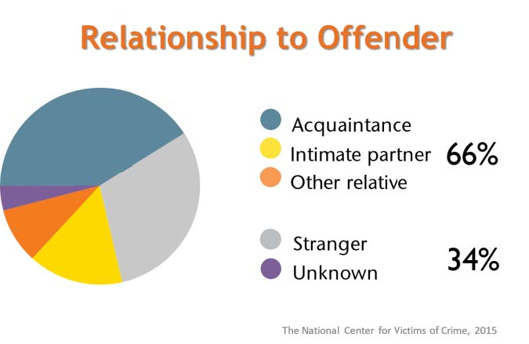
Complex Issues (cont.)
Only 14% of SA committed by strangers
The vast majority are known and trusted by the individual
Abuse of People with Disabilities
Notes:
Deb
According to Bustle article from spring of 2018 – “In general, most rapes aren't perpetrated by someone who's a stranger to the survivor — only 28 percent, according to RAINN's data — and people with intellectual disabilities are even more likely to be assaulted by someone they know. People with intellectual disabilities are assaulted by strangers just 14 percent of the time, NPR reports”
We could use somewhat older stats from the Arc - 97-99% of abusers are known and trusted by the person with an IDD
32% from family/friends
44% from professionals working with individual
Statistics from The Arc
NPR Investigative Series from Jan, 2018 – 14% stat as compared to 28 percent strangers in general population
Dept of Justice statistics previously unreported
Arc BRC report – Board Resource Center (figure at bottom)
Https://www.youtube.com/watch?v=yhLsATwO0o4
3 minute video clip from Board Resource Center

Slide 13
Why are people with I/DD more vulnerable?
Developmental
Social Cognitive Deficits
  Reading subtle cues
Executive Functioning
  Planning and organization
Central Coherence
  Theory of Mind
Cognitive Impairments
Speech-language impairments
Need to rely on others
  Compliance
Social
Taught to trust others
Desire for acceptance, love, inclusion of others
Lack awareness of crime
Loss of family, friends, caregivers
Comorbid psychological and social factors
Cases rarely prosecuted
Notes:
Morgan
Social Cog Deficits: Eye contact – paying attention to nonverbal communication (gestures and facial expressions) is challenging and then trying to interpret them
Cognitive Impairments – Concrete learning style (may have difficulty generalizing a rule across environments), difficulties with sequencing events or breaking down complex goals such as getting into a relationship to include meeting, getting to know eachother, friendship, asking person out, consent, dating, mutual decision to be in a relationship. Difficulty with sequencing can also contribute to challenges with SV reporting and prosecution
TOM – Difficulty seeing the perspective of others and separating that from one’s own perspective. This can make it challenging to understand concepts of respect, consent, and rejection
Stigmatization and social perceptions - adolescents with intellectual disability (ID) have smaller social networks, less access to informal sources of information and inferior sexuality knowledge compared to peers without ID (Aderemi, Pillay, & Esterhuizen, 2013; Jahoda, & Pownall, 2014). Overall, research shows that insufficient sexuality knowledge is a problem throughout the entire IDD population. Compared to typically developing peers, adolescents with autism spectrum disorder (ASD) and Down syndrome (DS) display less understanding of privacy, sexually appropriate behavior and sex education (Ginevra, Nota, & Stokes, 2016).
Social Cognitive Deficits - underdeveloped social skills and cognitive impairments contribute to the IDD population's increased vulnerability to abuse. For example, poor ability to ascertain subtle cues (i.e. safe vs. unsafe) and lack of theory of mind (i.e. judge other's intentions) can lead to the failure to recognize threatening relationships and situations (Dekker, Hartman, et al., 2015; Kim, 2015; Sevlever, et al., 2013). Alternatively, speech-language impairments may prohibit a child from stopping an advance or reporting abuse (Kim, 2015; Martinello, 2014; Sevlever, et al., 2013). The combination of ingrained behavioral compliance training (i.e. manipulation) and dependent relationships with caregivers (i.e. opportunity) makes lower functioning individuals unique targets for abuse
Other factors - anxiety, depression, post-traumatic stress disorder, substance use, poor self-esteem, isolation/loneliness, history of abuse, domestic violence, dysfunctional family environments, poverty, academic distress) escalate the risks for exploitation and abuse
Social
Activities of Daily Living, communication, mobility
Rarely prosecuted - Joe speaks to legal definitions and to them only being appropriate for the courtroom. If a person is describing what happened, use their words, their meanings. The technical charge is irrelevant
Lack of support services available based on expertise in sexual violence/trauma and understanding of people with I/DD
Ableism
Lack of regard as credible reporters
A lot of sexual violence is based on coercion and power and control and will most likely never make it to a courtroom because the law focuses on by force, against their will
We are still pushing to get legal definition to consent – we are fighting for the right of a person to withdraw consent during a sexual act
NC is not super behind the curve. The FBI just included anal penetration in their definitions in the 70s

Slide 14
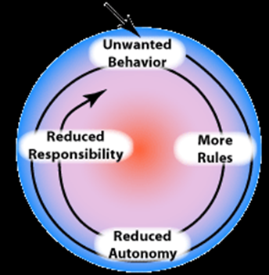
Even More Vulnerable
Greater Vulnerability associated with certain diagnoses:
ID
ADHD
ASD
Notes:
Morgan
ID
In studies exploring lifetime sexual experience, women with ID expressed problems with negative social attitudes (i.e. disapproval, oppression, over-protectionism), fears, delayed expression, denied experience and lack of self-efficacy (Barnett, & Maticka-Tyndale, 2015; Rushbroke, Murray, & Townsend, 2014). Stigmatized social perceptions of individuals with ID as unassertive, incapable of self-defense or unreliable witnesses may appeal to perpetrators and factor into heightened vulnerability (Lund, & Hammond, 2014).
ADHD
Another small body of research suggests that attention deficit hyperactivity (ADHD) symptoms Specific risk factors also exist for the ADHD subpopulation. Childhood ADHD symptoms correlate with an increased risk of interpersonal violence (IPV) (Gu(i.e. hyperactivity, impulsivity, inattention) predispose individuals to high-risk sexual behavior and subsequent interpersonal violenceendelman, et al., 2016). Recent studies contribute evidence that attribute risky sexual behavior in ADHD more specifically to symptoms of hyperactivity/impulsivity and that risky sexual behavior is a mediating risk factor for IPV (Hosain et al., 2012; Sarver et al., 2014; White, & Buehler, 2012).
ASD
Individuals with ASD may have sexual feelings that are out-of-sync with their level of social development and awareness
As kids grow older, their social and sexual skill sets are likely to become more disparate with their chronological age and appearance
Other people, however, will base expectations on their chronological age, NOT their developmental age
The ASD population is a main focus throughout the literature because multiple ASD symptom categories (i.e. social-communication deficits, restrictive interests and/or repetitive behavior, sensory issues) are associated with difficulties with sexuality and relationships (Beddows, & Brooks, 2016; Kellaher, 2015; Fernandes, et al., 2016). Expectedly, a recent study comparing adolescents with ASD, DS and typically developing peers, significantly correlates ASD diagnosis with the lowest psychosexual function (i.e. social behavior, privacy, sex education, sexual behavior, parent concerns) (Ginevra, et al., 2016). Evidence suggests young adults with ASD have significantly lower sexual awareness compared to those without a diagnosis (Hannah, & Stagg, 2016). Studies in adults with ASD reflect anticipated challenges related to social-communication deficits and sensory issues as well as reduced access to peer-based sexual socialization (i.e. exclusion, missed opportunities) and dissatisfaction with inadequate school-based sexuality education (Barnett, & Maticka-Tyndale, 2015; Hannah & Stagg, 2016).
Research shows higher incidence of problematic sexual behaviors among adolescents with ASD compared to other groups within the IDD population (e.g. Down Syndrome) and typically developing peers (Ginevra, et al., 2016; Visser, et al., 2017). Stronger evidence comes from a recent study of 1873 youth examining the relationship between autistic traits in childhood (age 10-12) and psychosexual problems (i.e. public exposure, touching genitals excessively, fixation, etc.) in early adolescence (age 12-15) (Dekker, Hartman, et al., 2015). Findings reveal that higher levels of autistic traits correlate with more psychosexual problems and an increase in autistic traits over time predicts more problems. Experts in the literature discuss theoretical explanations for the apparent disproportionate occurrence of inappropriate sexual behaviors in the ASD population. Restricted or repetitive patterns of behaviors, interests or activities (e.g. obsessions/preoccupations) and sensory issues (i.e. hypo/hyper-sensitivities) impact the experience of sexuality, such that misdirected curiosity about the human body or sexual stimuli may manifest as inappropriate behaviors (Beddows, & Brooks, 2016; Dewinter, Vermeiren, Vanwesenbeeck, Lobbestael, & Van Nieuwenhuizen, 2015; Kellaher, 2015).
Stokes, Newton, & Kaur (2007) examined the nature of social and romantic functioning in adolescents and adults with ASD. What they found was that individuals with ASD were more likely than their NT peers to engage in inappropriate courting behaviors; to focus their attention on celebrities, strangers, colleagues, and exes; and to pursue their target for longer lengths of time (i.e. stalking).
Stokes, M., Newton, N., & Kaur, A. (2007). Stalking, and social and romantic functioning among adolescents and adults with autism spectrum disorder. Journal of Autism and Developmental Disorders, 37, 1969-1986.
Perpetration…
Sex offenses are the second most common crime among people with intellectual disability
Nearly 50% of incarcerated offenders with intellectual disability committed a sexual offense
Disproportionate representation - Approximately 6.5 million people in the United States have an intellectual disability. Approximately 1 – 3 percent of the global population has an intellectual disability—as many as 200 million people.
Intellectual disability is significantly more common in low-income countries—16.41 in every 1,000 people. Disabilities overall are more common in low-income countries.
The United Nations Development Program estimates that 80 percent of all people with disabilities live in low-income countries. While people with disabilities represent approximately one in 10 people worldwide, they are one in every five of the world’s poorest people.
Sources: American Association of Intellectual and Developmental Disabilities; National Center on Birth Defects and Developmental Disabilities; the United Nations Development Program; and the Centers for Disease Control and Prevention.
The most frequent sexual offenses reported in one study were indecent exposure, other minor offenses, and sexual assault of young girls (Day, 1997). Another nationwide study that surveyed 243 community agencies found the most common sexual offenses were inappropriate sexual behavior in public (62.2%), sexual behaviors and stimulation that inappropriately involved others (42.6%), sexual activity involving minors (42.6%) and assaultive/nonconsensual sexual activity not involving minors (34.5%) (Ward et al, 2001). Another study found the most common sexual behaviors are those seen among people without intellectual disability – offenses against children, genital exposure and rape (Murphy, et al., 1983).
The Arc 2013

Slide 15

Common Misconceptions and Outcomes
Common Misbeliefs | Policy and Practice | Outcomes
Childlike Innocence | Overemphasize protection and undervalue their children's autonomous right to express sexuality and experience intimate relationships | Shielding individuals with IDD from information about sexuality disempowers them and exacerbates their risks for sexual violence
Oversexed/Sexually Aggressive | Oppression based on fear that information will exacerbate or result in inappropriate sexual behaviors. Exclusion from school-based SRE or limited SRE instruction focused abuse protection and risk avoidance | Abuse protection and risk avoidance dominate and overshadow information that affirms positive aspects of sexuality and encourages healthy psychosexual development
Asexual – No Interest | Presumption that sexuality education is irrelevant, Deprioritized SRE for this population, problem-based model for sexuality education, sexual health topics are avoided or seen as irrelevant | Limited access to SRE or a limited curriculum focused on abuse protection and harm reduction. Maladaptive understanding of human sexuality and relationship intimacy.
Insert Text
Insert Text
Notes:
Morgan
Thinking back to the history of I/DD, here are some antiquated misconceptions that have contributed to disproportionate vulnerability
15

Slide 16
How do we reduce sexual violence among Individuals with I/DD?
Caregivers
Individuals
Community
Self-Advocacy
Comprehensive Sex Education
Sexual Health
Social Skills Training
Clarify values
Education regarding risks
Encourage Communication
Modeling appropriate behaviors
Sexual diversity education
Sensitivity training
Establishing community partnerships
Training for sex educators
We’ll focus mostly on sex education!
Notes:
Morgan
Reporting can be increased by educating individuals with disabilities and service providers about sexual violence, improving the investigation and prosecution of this crime, and creating safe environments that allow victims to disclose.
Establishing community partnerships - Creating systems of care that really work. Together.

Slide 17
Examples of addressing SV in DD Community – U.S.
Sexual Health Equity for Individuals with IDD: Project SHEIDD – Portland, OR
Community collaboration
Policies and procedures
Inclusive, adaptable materials
Identify needs and resources
Notes:
Deb
OHSU – Oregon Health & Science University in Multnomah County Oregon (Portland)

Slide 18
Examples of addressing SV in DD Community – U.S.
Project SHIELD - King’s Co. NY - DA Office
Criminal Justice + Community response to victims with IDD
Effective investigations/prosecutions
Education and awareness: providers, law enforcement, individuals with IDD, the community
Notes:
Deb

Slide 19
Promising Practices: MA Disabled Persons Protection Commission (DPPC)
Adult Protective Services Enhancement Grant:
Access to trauma/victim services for adults with IDD: trauma-informed care
Goals 1) Navigators, 2) Peer support,
3) Clinical matching, 4) Advisory committee
Key partners > system change: Victims Rights Law Ctr, RCC, DD Services
Notes:
Deb

Slide 20
NC Models in recent years
New Horizons Model: RCC + DD staff
Project Illumination: Build team
NC CASA: Advisory IDD subgroup
SHIFT NC Sexual Health Initiatives for Teens: Reaching teens with IDD
Notes:
Deb

Slide 21
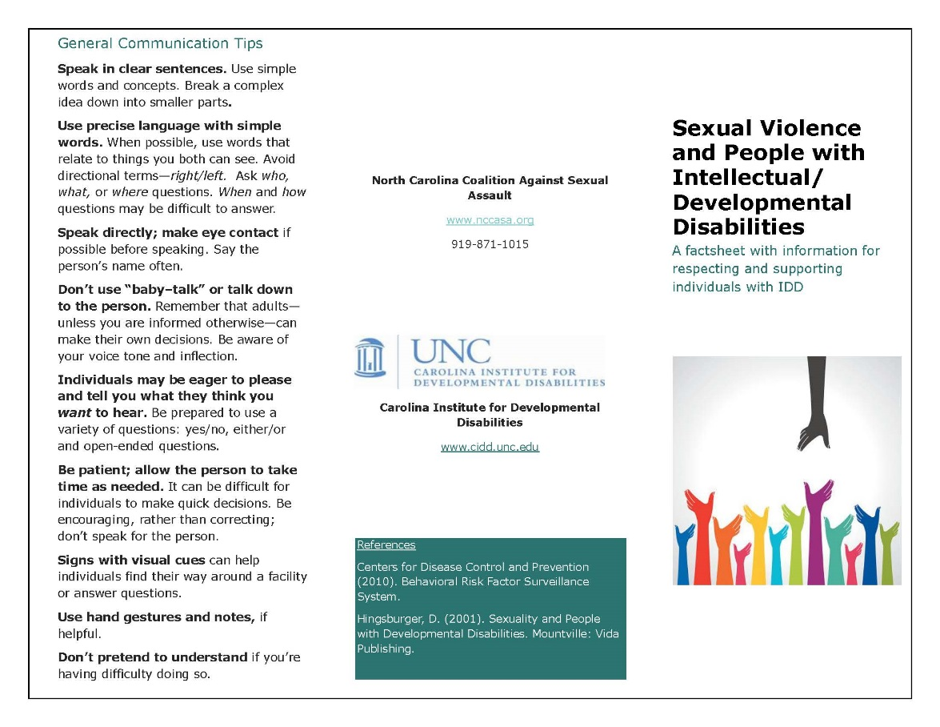
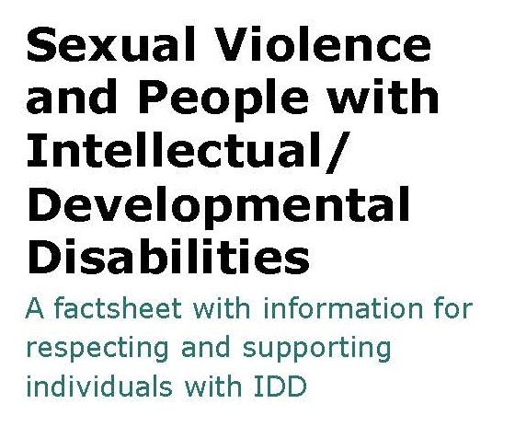
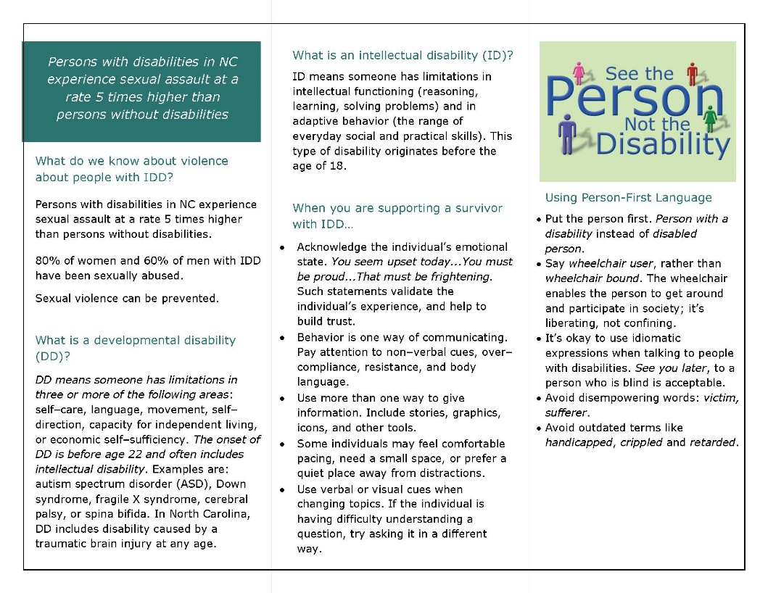
North Carolina Sexual Violence Prevention Advisory Board
Notes:
Morgan

Slide 22
“May I?” Movement
Date Safe Project
  Asking First for Consent.
  Making Smarter Choices with Partners
  Supporting Survivors of Sexual Assault
  Intervening when Danger is Present at Parties and Group Settings with Alcohol
Notes:
Morgan
Helpful to talk through expected social norms with touch (expected and unexpected and consequences of each)
“May I” campaign. He started this campaign of asking may I before shaking hands, giving a hug, any physical touch.
Date Safe ProjectFounded2003FounderMike Domitrz^{[1][2][3]}Area served
United States and GlobalProductsVoices of Courage,^{[4]} May I Kiss You?^{[5]}Websitedatesafeproject.orgThe Date Safe Project is an anti-sexual assault organization in the United States which provides prevention materials and advocacy programs for middle schools, high schools, universities, community organizations, and the United States Military.[6][7][8][9][10][11][12][13][14] Headquartered in Milwaukee, Wisconsin, The Date Safe Project addresses consent, sexual assault awareness, bystander intervention, and support for survivors of rape.^{[15][16][17][18][19][20]}
The organization was formed by the American educator, activist, author and publisher,^{[21]} Mike Domitrz, in 2003 after his sister was sexually assaulted.^{[22]}
Cornell – what messages should we be giving our communities to help educate them on positive behaviors “May I” campaign. He started this campaign of asking may I before shaking hands, giving a hug, any physical touch.

Slide 23
How to Recognize Signs of Abuse
Physical
Sexual
On the body:
Bruises
Welts
Burns
Fractures
Cuts/lacerations
Behavior:
Extremes in moods
Frightened of you/others
Doesn’t want to be touched
Gets upset when another child cries
Reports someone hitting him/her
On the body:
Torn/stained/bloody underwear
Genital pain/ itching
Bruises, bleeding or swelling of genitals
Has acquired STI
Has semen on mouth or genitals
Is pregnant
Behavior:
Withdraws or engages in infantile behavior
Does not want to do any physical activity
Hides in room
School avoidance
Trying to tell you something but does not
Notes:
Morgan

Slide 24
If a survivor discloses to you:
What you say
…can make a healing difference
I believe you.
It’s not your fault.
You’re not alone.
I care about you and I’m here to listen and help in any way I can.
I’m sorry this happened--this shouldn’t have happened.
You survived; obviously you did the right things.
Thank you for telling me.
Notes:
Deb

Slide 25
If a survivor discloses to you:
What you do
…can make a healing difference
Validate feelings about the experience, acknowledging pain without catastrophizing.
If they minimize, no need to agree; hurt and pain are real
Express admiration for their courage and recognize how difficult this experience must have been for them.
From: Know Your IX-Advocates for Youth; RAINN [Rape, Abuse & Incest National Network]; The Arc
Notes:
Deb

Slide 26
If a survivor discloses to you:
What you do
…can make a healing difference
Avoid judgment. Effects of SV can last for an extended period of time.
Check in periodically. The event may have happened a long time ago.
Know your resources. OCRCC, RAINN,…
Notes:
Deb

Slide 27
If a survivor discloses to you:
Reporting/Seeking Support/Getting Involved
Contact your county’s Department of Health and Human Services http://www.ncdhhs.gov/dss/local/index.htm
Prevent Child Abuse North Carolina 1-800-CHILDREN
RAINN (Rape, Abuse & Incest National Network) is nation's largest anti-sexual violence organization www.rainn.org or 800-656-HOPE (RAINN)
1-800-4-A-CHILD a National Child Abuse Hotline
NC Rape Crisis Centers
North Carolina Coalition Against Sexual Assault: http://www.nccasa.org/
Family Physician or Pediatrician
Mental Health Center
Health Department
Notes:
Deb
From the Arc: All states have laws requiring professionals, such as case managers, direct care workers, police officers and teachers to report abuse. Some states require the general public to report abuse as well. If you suspect a child is being sexually abused, contact your local child protective agency. If the person is an adult, contact adult protective services. These are also referred to as “Social Services”, “Human Services” or “Children and Family Services” in the phone book. You do not need proof to file a report. If you believe the person is in immediate danger, call the police. After a report is made, depending on how serious the abuse is, the incident is referred for investigation to the state social services agency (who handles civil investigations) or to the local law enforcement agency (who handles criminal investigations).
For more information on how you can help prevent sexual assault/abuse, contact Prevent Child Abuse America at 1-800-555-3748 (200 S. Michigan Ave., 17th floor, Chicago, IL 60604) or visit their web site at www.preventchildabuse.org and The Arc Riverside’s CAN DO! Project at www.disability-abuse.com
RAINN
How does it work?
When you call 800.656.HOPE (4673), you’ll be routed to a local RAINN affiliate organization based on the first six digits of your phone number. Cell phone callers have the option to enter the ZIP code of their current location to more accurately locate the nearest sexual assault service provider.
RAINN (Rape, Abuse & Incest National Network) is the nation's largest anti-sexual violence organization. RAINN created and operates the National Sexual Assault Hotline (800.656.HOPE, online.rainn.org y rainn.org/es) in partnership with more than 1,000 local sexual assault service providers across the country and operates the DoD Safe Helpline for the Department of Defense. RAINN also carries out programs to prevent sexual violence, help survivors, and ensure that perpetrators are brought to justice.
http://www.nccasa.org/cms/need-help/nc-rape-crisis-centers

Slide 28
What are we doing at CIDD?
Collaborating with community partners
Sexual Relationship Education for teens and their caregivers
Notes:
Deb

Slide 29
Collective Impact - Address complex, large-scale issues
Five conditions
  Common Agenda
  Shared measurement
  Mutually reinforcing activities
  Communication
  Backbone support
Notes:
Deb

Slide 30
Our Collective Impact:
15+ Committed NC Partners
  Self-advocates/family advocates
  NC Council on DD
  Educators (NC DPI)
  SANE Training Coordinator
  RCCs
  NC DHHS – IDD specialists
  Speech-Language Pathologist
  Sexuality Educators
Notes:
Deb

Slide 31
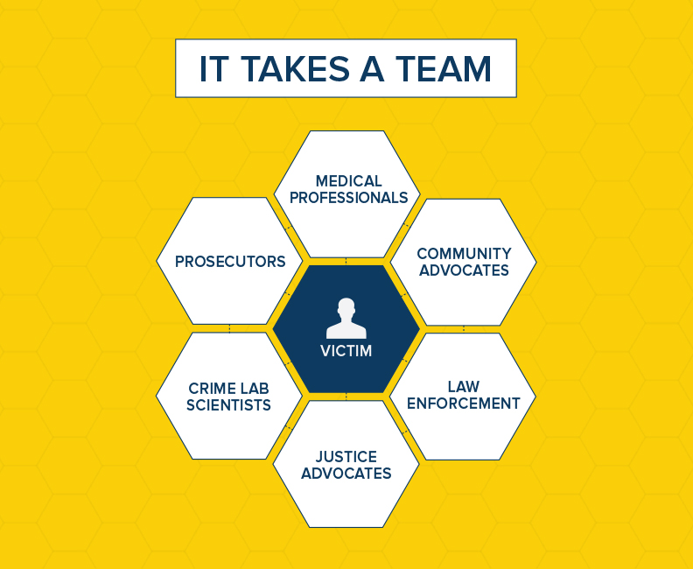
Consider all Stakeholders
And, they all need training regarding how to effectively interact with, interview, and support individuals with I/DD
Notes:
Morgan – CHANGE TO SURVIVOR!!!
Who they are, the challenges faced, the impact of sexual violence within the community, potential consequences of reporting, challenges to accurate reporting
Question your own assumptions, attitudes, and values and your role in supporting individuals with I/DD

Slide 32


Prevention through Education
Sexuality Information and Education Council of the United States (SIECUS)
Comprehensive sexuality education
  Health Promotion
  Risk Reduction
  Harm Prevention
Notes:
Margaret
(Sexuality Information & Education Council of the United States, 2012). SIECUS - a recognized leader in the field of sexuality and sexuality education, publishing numerous books, journals, and resources for professionals, parents, and the public.
Comprehensive sexuality education
promotes positive aspects of sexuality and prevents negative consequences (Jahoda, & Pownall, 2014; McEachern, 2012; Wiggins, et al., 2013). Interventions addressing the need for comprehensive sexuality education in the IDD population possess the unique potential to simultaneously address health promotion, risk reduction and harm prevention (Martinello, 2015; McEachern, 2012; Wiggins, et al., 2013).

Slide 33
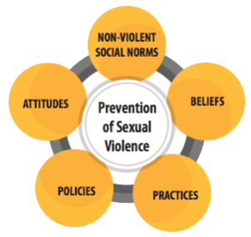
Comprehensive Sexuality and Relationship Education (SRE)
Curriculum should incorporate information, skills, and exploration of values
SIECUS guidelines
  6 Focus Areas
    Human Development
    Relationships
    Personal Skills
    Sexual Behavior
    Sexual Health
    Society and Culture
Notes:
Margaret
The Sexuality Information and Education Council of the United States (SIECUS) (2004) recommends that sexuality education programs incorporate information, skills and exploration of personal values. SIECUS guidelines outline essential curricula, including thirty-nine topics in six focus areas: human development; relationships; personal skills; sexual behavior; sexual health; society and culture (2004). In this respect, the sexuality education needs of adolescents with IDD are the same as typically developing peers. However, adolescents with IDD confront many obstacles with respect to sexuality education, including barriers imposed by negative social attitudes and impediments that arise from characteristics inherent to IDD.
Talk early, talk often, talk all the time

Slide 34
Nothing About Us Without Us
What does it mean?
The disability community has had enough of being put aside and powerless
It’s about self-determination and the disability community making its own decisions
A social movement focused on liberation from systemic worldwide oppression for people with disabilities
Notes:
Morgan
Teach parents, educators, and caregivers the importance of sexual health advocacy and sexual self-advocacy.
Sexual Self Advocacy
https://www.youtube.com/watch?v=bXOJ3uDxkp4
Brzuzy, Stephanie (1999) "Nothing About Us Without Us: Disability, Oppression and Empowerment. James I. Charlton. Reviewed by Stephanie Brzuzy, Arizona State University.," The Journal of Sociology & Social Welfare: Vol. 26 : Iss. 1 , Article 14. Available at: https://scholarworks.wmich.edu/jssw/vol26/iss1/14

Slide 35
Barriers to SRE in I/DD
Historically neglected, inadequate
  Provided in response to problem behaviors
Dearth of Research on SRE in I/DD
Fragmented systems of care
Programs needed to be targeted toward:
  Self-Advocates
  Parents/Family Members
  Support Staff
Notes:
Margaret
Sexuality education for the IDD population is laden with challenges. The nature of sexuality, characteristics of the target population and negative social attitudes intersect with aspects of the health care system to create numerous barriers. Many factors related to acceptance (i.e. attitudes), motivation (i.e. prioritization), preparation (i.e. education, training) and support (i.e. funding, research) function as potential barriers to the implementation and sustainability of sexuality education for the IDD population. Consequently, sex education has traditionally been neglected, inadequate or implemented only in reaction to problems in the IDD population (Holmes, et al., 2014; Sevlever, et al., 2013; Tullis, & Zangrillo, 2013).
Research
The paucity of research on sexuality education in the IDD population is a significant barrier because sufficient quality research is necessary to guide policy development and establish evidence-based practice. Characteristics of the IDD population contribute to the paucity of research. Reluctance to work with challenging IDD characteristics (i.e. cognitive, social deficits) may deter efforts to conduct direct research in the IDD population (Thompson, et al., 2014). Furthermore, the adolescent IDD population is considered vulnerable by two accounts, age and disability. Mirroring society, vulnerable populations are often marginalized in the health care system. For example, increased difficulty with IRB approval may deter research efforts. Broad implications of the marginalization of vulnerable populations include significant oversights and omissions from professional education and research as well as health care policy, finance and care delivery systems. Accordingly, research is likely scarce due to cascade of other system level barriers, such as low prioritization and lack of funding.
Sexuality education requires collaboration between multiple stakeholders, including parents, adolescents and multidisciplinary professionals. However, the highly fragmented United States health care system segregates practice specialties and impairs collaboration (Brown-Levey, Miller & deGruy, 2012; Mandersheid & Kathol, 2014). Furthermore, the current specialty-focused structure muddles responsibility for complex multidimensional (i.e. encompasses aspects of physical, mental, emotional, social and spiritual health) issues such as sexuality education causing important aspects of holistic health care to become lost within a highly fragmented system.
Caregivers worry about whether they have the right to provide information – guardianship is tricky

Slide 36
Consequences of Inadequate Sexuality Education
Increased negative health outcomes
  STIs
  Unwanted pregnancies
Psychological Implications
  Anxiety
  Distress
  Low self-esteem
  Negative body image
Social Isolation
Notes:
Margaret
Consequences of Inadequate Sexuality Education
Associated with physical changes associated with puberty or that may be caused by hormonal changes
Inadequate understanding of contraception, protection methods or personal hygiene increases the risk for negative sexual health outcomes such as sexually transmitted diseases or undesired pregnancies (Ball, 2012; Holland-Hall, & Quint, 2017; Quint, 2016). Lack of awareness of physical pubertal development leads to anxiety, distress, low self-esteem or negative body image (Cridland, et al., 2014; Holland-Hall, & Quint, 2017; Jahoda, & Pownell, 2014). Poor coping (i.e. confusion, frustration or anxiety) related to the physical and hormonal changes of puberty and medication effects (i.e. libido) also influences sexual behavior (Beddows, and Brooks, 2016).
Social Isolation – further perpetuates the social stigmatization. Social marginalization often compounds difficulties related to social skills deficits and interferes with the formation and maintenance of meaningful relationships (Corona, Fox, Christodulu, & Worlock, 2016; Dekker, Hartman, et al., 2015; Tullis, & Zangrillo, 2013). Consequently, a lack of fulfilling relationships leads to reduced quality of life (i.e. dissatisfaction, loneliness, distress, depression or other mental health problems) and the missed opportunity for personal growth and satisfaction (Chan,
Conversely, comorbid social and psychological problems (e.g. anxiety, depression, post-traumatic stress disorder, substance use, poor self-esteem, isolation/loneliness, history of abuse, domestic violence, dysfunctional family environments, poverty, academic distress) escalate the risks for exploitation and abuse (Guendelman, et al., 2016; Lund, & Hammond, 2014; Wiggins, Hepburn, & Rossiter, 2013).

Slide 37
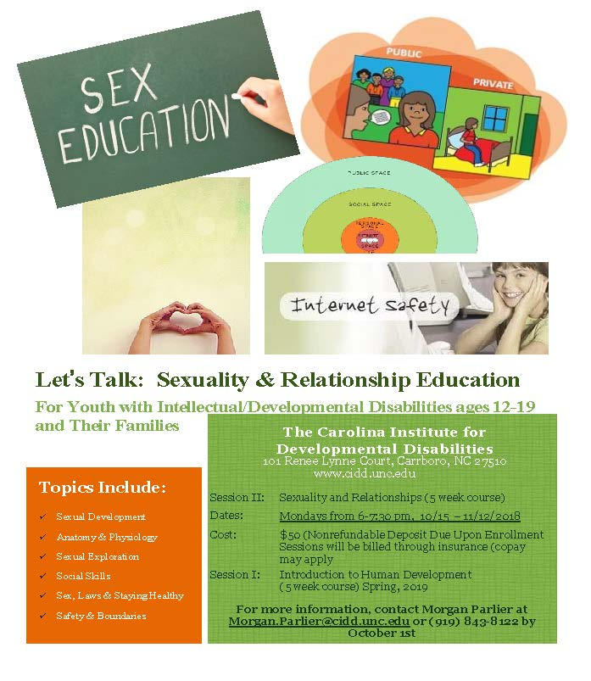
Sexuality and Relationship Education for Youth with I/DD and Caregivers (SRE)
Notes:
Margaret
In response to expressed need by families
Based on SIECUS
http://www.sexedlibrary.com/index.cfm?pageId=721

Slide 38
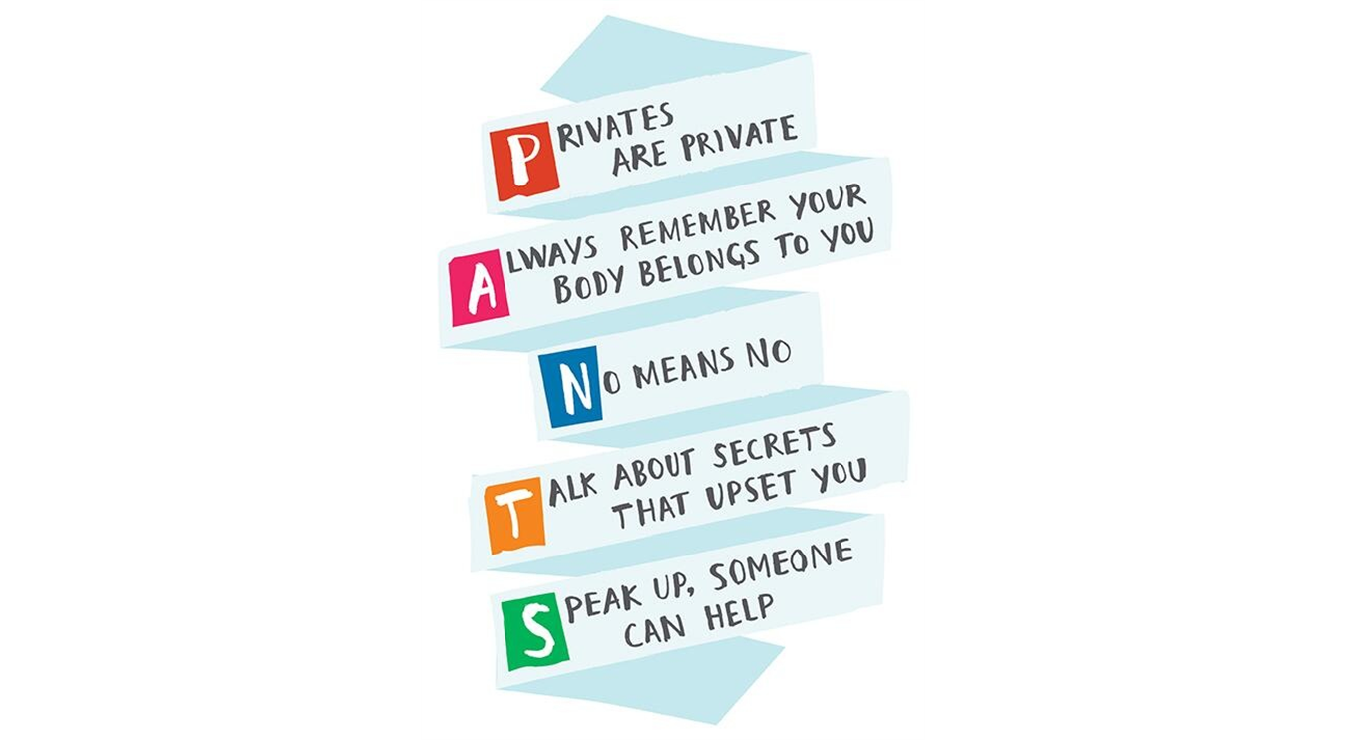
LET’S TALK: SRE Overview
Part One: Human Development
Human Development
Anatomy & Physiology
Puberty
Safety & Boundaries
Social skills
Part Two: Sexuality and Relationships
Dating and relationships
Sex, Laws and Staying Healthy
Sex, sexuality, and healthy behaviors
Notes:
Margaret
How is a person with a developmental disability’s experience of developing the same as someone without a disability?
Assigned gender
Gender roles reinforced
Biological changes
Need same information, based on biological age
Have sexual feelings and needs
Have dreams like anyone else might, relationship, babies
How is a person with a developmental disability’s experience of developing the different than someone without a disability?
People don’t discuss topic
Think they are oversexed
Higher rate of abuse
Behaviors are accepted or forgiven
Lack friendships, social opportunities
Don’t pick up on the social cues
How you teach topics is different
Often lack privacy to explore their sexuality
Many parents let go of dreams for child related to sexuality or think of them as not sexual
Relate the topics you cover to sexual violence prevention
- this is done directly in part two, where we cover consent, safety, boundaries
This is done indirectly in part one, anatomy gives words to help with reporting, boundaries
Holistically, learning to communicate about sex and sexuality destigmatizes and demystifies

Slide 39

The Role of CAREGIVERS in SRE
Start conversations
Better understand child’s perspective
Give correct information about sex and teach them to use correct language for their own body parts
Answer questions honestly
Share family beliefs, concerns and values
Talk with child’s teachers as well
Notes:
Morgan
Studies show that young people tend to obtain most of their information (or misinformation) about sexuality from friends.
Tell your children what they want to know using words they can understand.
Some children never ask about sexuality
Your children need to know where you stand.
Receives consistent messages from all educators
Parents are primary sexuality and relationship
educators from birth forward:
Children learn from:
the way they are touched by others
the way their bodies feel to them
what their family believes is okay and not okay to do
the words that family members use (and don’t use) to refer to parts of the body
watching the relationships around them

Slide 40

Common Values
Common values that we can all agree upon are OKAY to express:
  It is important to respect others by treating them well and listening to them
  It is important to get consent from a sweetheart for being sexual
  It is important to be responsible in a romantic relationship
  Relationships should be equal and positive without violence or abuse
  Sex should be safe and pleasurable for all
Notes:
Morgan
For those supporting people with developmental disabilities, it is important to challenge our own beliefs and values and to recognize when personal values are irrelevant. If we work with individuals in a professional capacity, then we have to abide by organizational policies while also promoting the individual’s self-determination. In order to avoid our own blindspots, we have a responsibility to evaluate our own assumptions.
I attended a wonderful training last fall with Elevatus Training - Katherine McLaughlin, M.Ed.
Katherine is certified as a sexuality educator by AASECT (American Association of Sexuality Educators, Counselors and Therapists) and is the Founder of Disability Workshops, now Elevatus Training, LLC. She is the Director of Training and delivers our live and online trainings. She is the author of Sexuality Education for People with Developmental Disabilities Curriculum and also develops educational materials for others to use in teaching and communicating.
During training, we were asked to agree/disagree with a series of values statements. One of them challenged my personal values:
It is okay for two people with disabilities to have a child.

Slide 41

Where to Start with Students with I/DD
?
Start with the basics:
Use correct terminology
Provide accurate information
Encourage questions
Notes:
Margaret

Slide 42
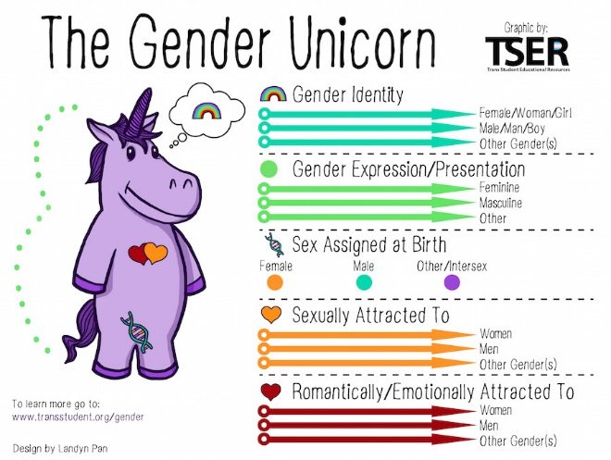
Notes:
Margaret
Teach sexual diversity
Trans student education resources
It is an umbrella term used to describe people whose gender identity and gender expression differs from that which is usually associated with their birth sex or assigned sex.
Gender expression = how we express our gender, clothing, haircut, voice or body characteristics
Gender identity = the person’s sense of self as male or female, an innate sense, deeply psychological identification as male or female which may or may not match their biological sex
Sexual orientation is who the person is erotically, romantically, and affectionately attracted to, male female or either
Gender Identity is your sense of self as male, female or transgender
Autistic people are seven times more likely to be gender non-conforming than the general population. Interviewed at gender clinics, 10 times more like to have a diagnosis of autism than the general public.
The “double rainbow” of being both autistic and LGBTQIA+
Autism does not guarantee asexuality, nor are Autistic people’s identities always heterosexual and cisgender
Parallel to coming out and coming out as autistic
https://www.twainbow.org/

Slide 43
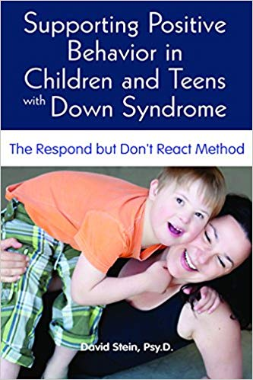

Terri Cowenhouven
The 4 P’s-
  Permission
  Privacy
  Pleasure
  Protection
Notes:
Margaret
Terri Couwenhoven MS, CSE is a well known sex educator and author, specializing in the design and implementation of sexuality programs and resources for people with cognitive disabilities, their parents, and the professionals who support them. Her gentle, matter-of-fact approach combined with extensive knowledge and experience make her a popular speaker with self advocates, parents and professionals around the country.Yes, we do have sexual rights. But with rights comes responsibility! Here are your responsibilities IF you choose to have sex…
Privacy– No sex by yourself or with anyone else without privacy! Having privacy means you have a closed and locked door, where no one can SEE or HEAR you.
Permission– No sex with anyone who does NOT agree or is UNABLE to agree. Both people HAVE to say yes!
Protection– No sex without trying to protect yourself by using condoms and plastic barriers. This may keep you from getting an STD, or sexually transmitted disease. Condoms may also keep you from getting pregnant.
Person 18 or older– No sex with anyone who is 17 years or younger, children or teenagers. Even if they say yes, it still against the law!
If you follow The Four P's while having a sexual relationship, you will be LEGAL and SAFE.

Slide 44
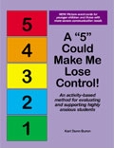

Teaching Strategies
Small groups
Caregiver participation
Multi-modal learning
Slower pace
  More opportunity for practice
Repetition
Teachable moments
Notes:
Margaret
How is this sex ed tailored to people with I/DD?
No more than 3:1 ratio of instructors to youth
Caregiver/Parents – we will touch on momentarily
Multi-modal Learning
Slower Pace – repetition of concepts, visual supports, modeling and role plays for practice, social behavior mapping for decision making
Teachable Moments – we will touch on later

Slide 45





Safe Touches

Slide 46

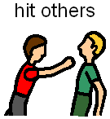
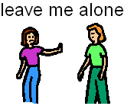

Unsafe Touches

Slide 47


Confusing Touches
Sometimes touches make you feel good and other times the same touch can make you feel uncomfortable.
What does uncomfortable mean?

Slide 48
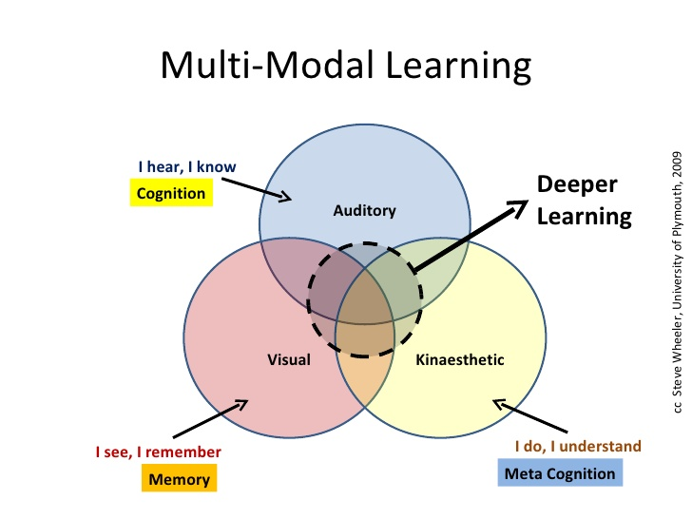
Multi-Modal Learning
  Visual aids
  Hands-on activities
  Role plays
  Social Behavior Mapping
  Question Box
  Modeling concepts of consent and bodily autonomy
  Discussion
Notes:
Margaret

Slide 49
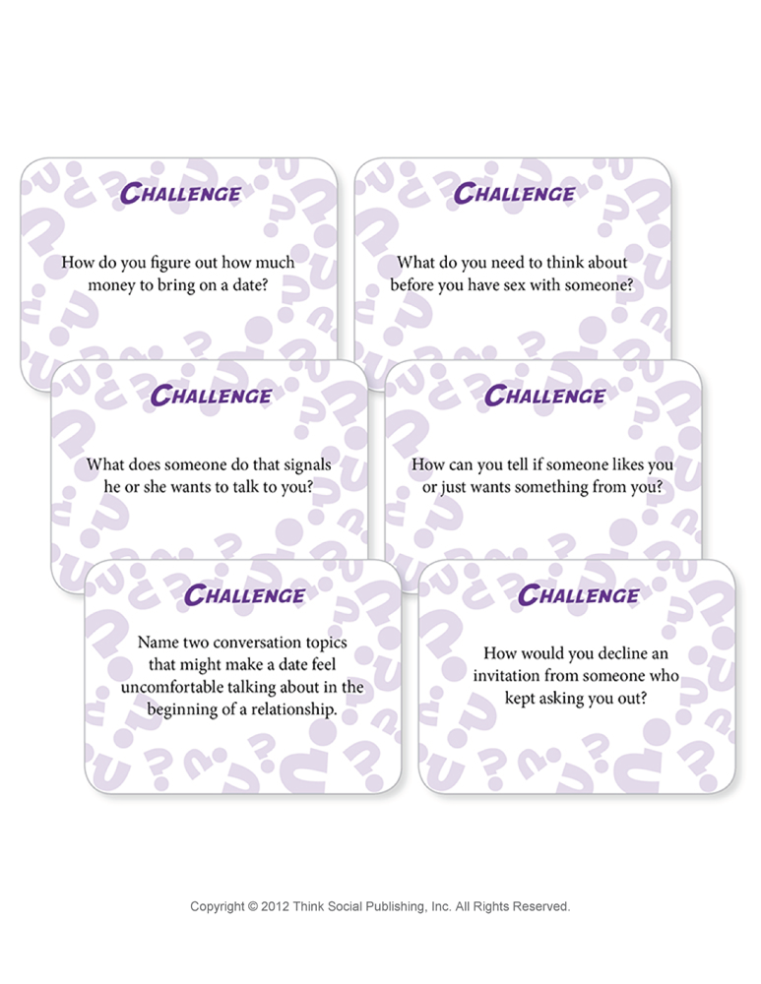
Decision Making Skills
Decision Trees
Social Behavior Maps
Flow Charts
Notes:
Margaret

Slide 50
Garcia Winner, M. (2007) Social Behavior Mapping
Notes:
Garcia Winner, M. (2007) Social Behavior Mapping

Slide 51
Garcia Winner, M. (2007) Social Behavior Mapping

Slide 52
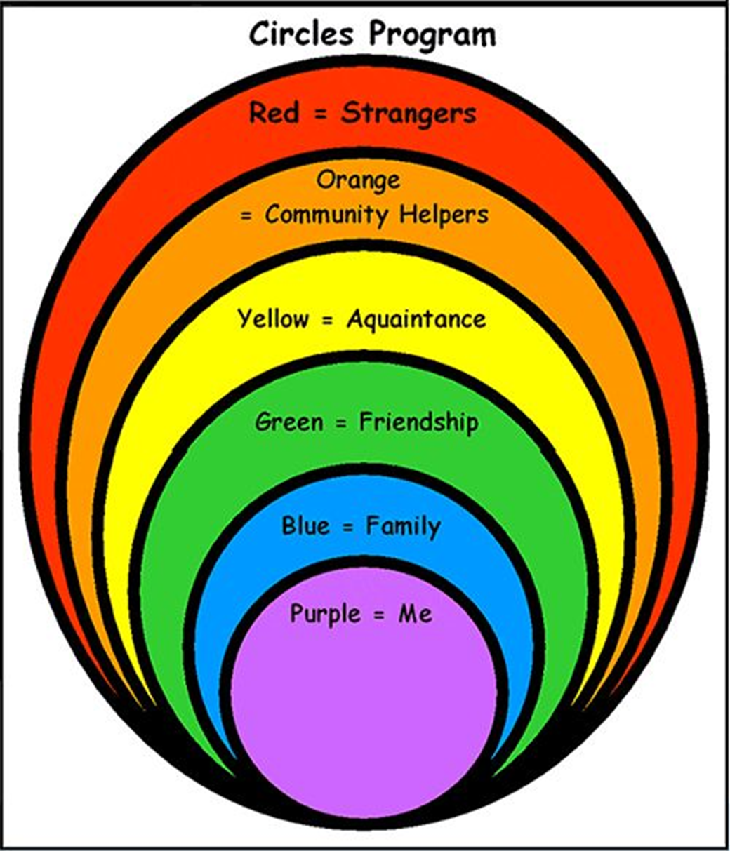
Circles of Social Relationships
Who would go in each of your circles?
Can people move from one circle to another?
How should you act and what could you do with the people in each circle?
In which circle do boyfriends/ girlfriends go?
Acquaintances, Neighbors, Community Helpers:
You may shake their hand or wave to them
Greet and say hello
Talk about relevant information
Strangers
Keep your distance from them
Do not share personal information
Notes:
Margaret

Slide 53
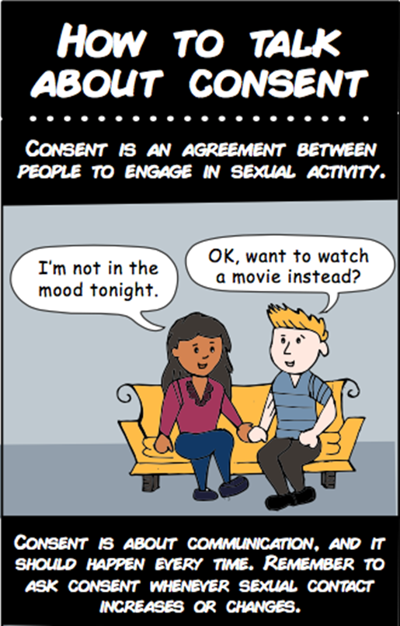
Social Rules and Safety
Self-Control
Rights of Self and Others
  Respect
  Rejection – How to handle it
  Good Decision Making
Bodily Autonomy
  Consent
  Ways in which parenting can contradict education on consent
Public vs. Private
Notes:
Margaret
Taught in terms of emotional regulation – self control activity, A 5 is Against the Law
Refer to youth social skills activities, Florida Social Skills handouts
Consent - Informed consent means that the person is aware not just of their rights but also their responsibilities. Both parties are expected to fully understand how women get pregnant, methods of birth control, sexually transmitted diseases, how to use a condom, be able to define sexual abuse, and can say “No” appropriately and effectively.
Tickling rough housing – stop when they say no
Contradicting their feelings – if they say “I’m hungry” and we say “No, you’re not. You just ate.”

Slide 54
Public Vs. Private
Notes:
Margaret

Slide 55
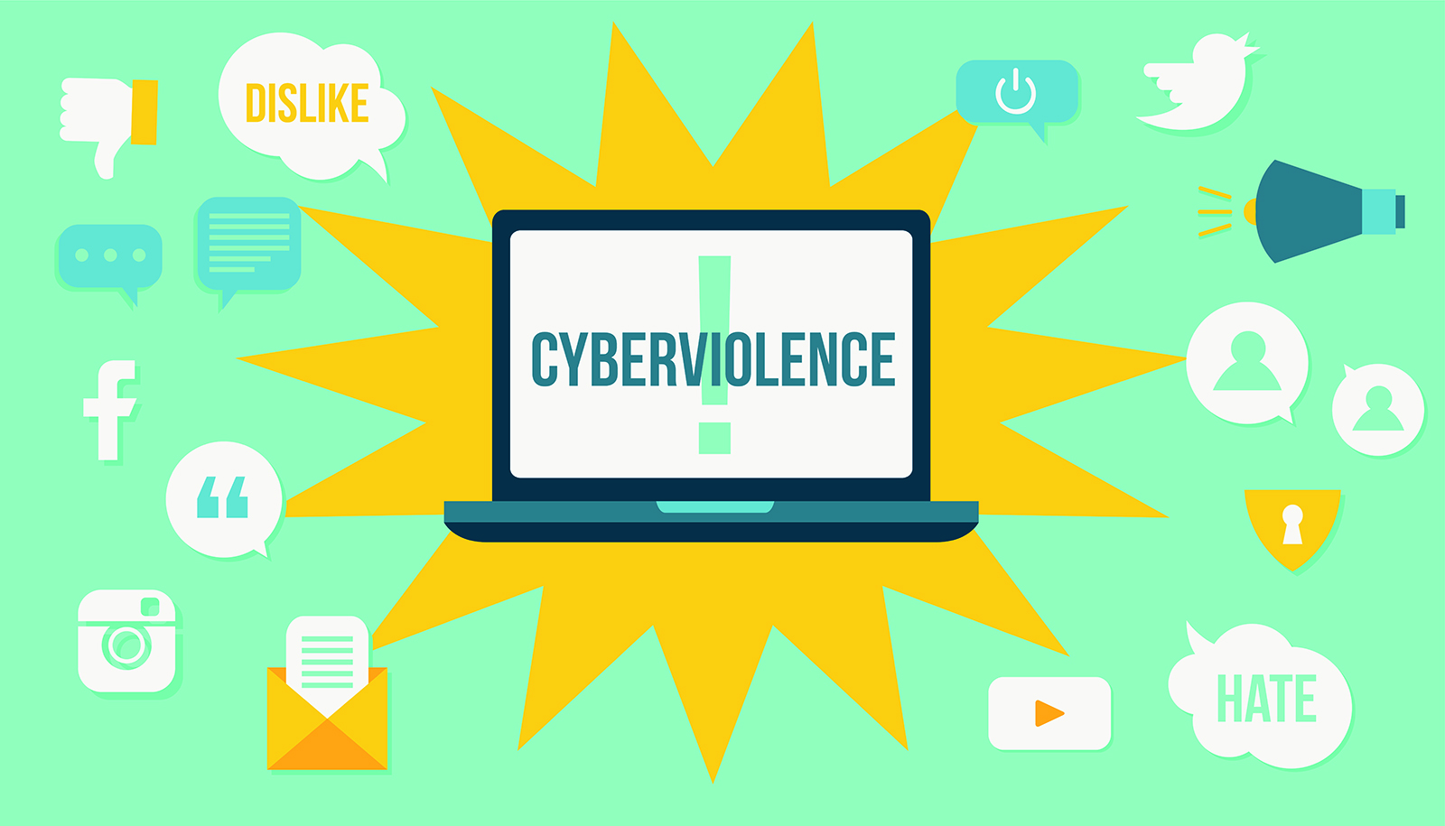
Consider Technology
Teach internet safety
  Social Media Sites
  Email
  Chatting/IMing
  File Sharing
Smart phones and texting
Cyber bullying
Notes:
Margaret
Some people use technology—such as photos, videos, social media, and dating apps—to engage in harassing, unsolicited, or non-consensual sexual interactions. It can leave the person on the other end feeling manipulated, unsafe, exposed, and worried about their online reputation. The laws pertaining to these situations vary from state to state and platform to platform and they are evolving rapidly. Learn more about these situations so you can feel better prepared to report and protect yourself if they happen.
What are some ways people use digital technology to hurt others?
The following list includes some of the ways a person can use digital technology in a sexually explicit or violating way.
Catfishing, or lying about one’s identity online in order to initiate a romantic or sexual relationship
Cyberbullying, or the “willful and repeated harm inflicted through the use of computers, cell phones, and other electronic devices” often to threat, harass, or humiliate another, according to the Cyberbullying Research Center
Cyberstalking by monitoring someone’s whereabouts with GPS or other tracking systems or persistently contacting someone against their will through text, email, social media, or other digital platforms
Distributing or threatening to distribute sexual or intimate images of someone without their consent, also known as digital sexual assault or revenge porn
Hacking into someone’s online accounts or devices to steal personal images or information not intended for public sharing
Harassing someone through an online gaming platform or forum
Posting shaming, embarrassing, sensitive, or otherwise inappropriate information about someone on social media or other public sites, whether it is true or not
Pressuring you to send explicit images of yourself Sending sexually explicit emails, chats, texts, photos, videos, or emojis that are unwelcome or unsolicited
Taking sexually explicit pictures or videos of someone without their consent
Trolling, or deliberately posting upsetting or provocative statements or photos in order to provoke others
Unsolicited or unwanted sharing of pornography or pornographic images

Slide 56
Learn the Rules
Must know the rules in order to teach them
Rules vary by environment:
  School
  Home
  Community
Rules vary by relationship:
  Family
  Friends
  Community Helpers
Know the laws
  To research your local laws: https://www.rainn.org/laws-your-state-north-carolina
Notes:
Margaret
Policies for in school offenses

Slide 57

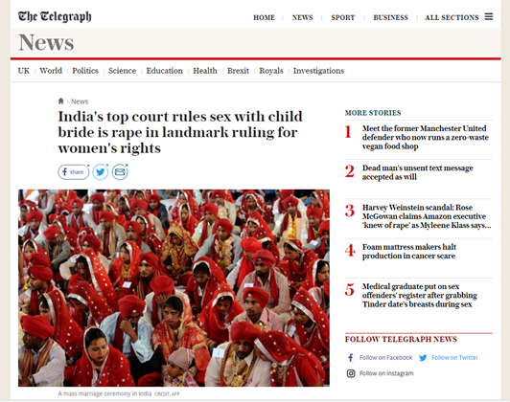
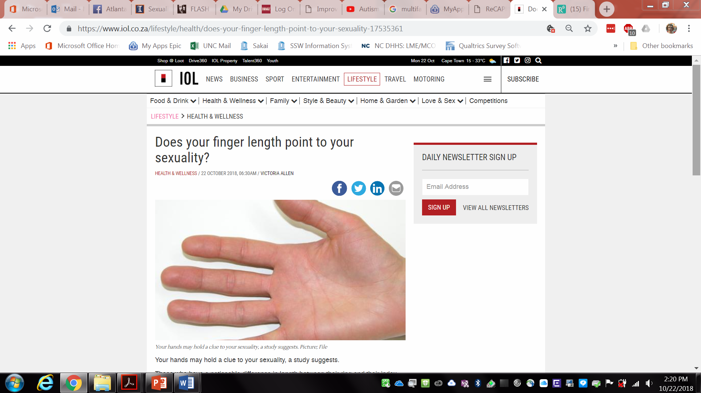
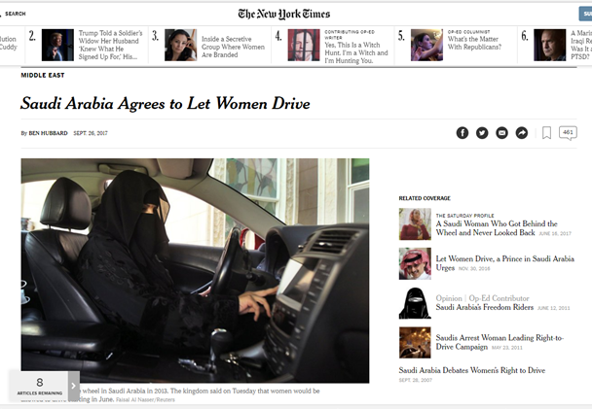

Teachable Moments
Notes:
Margaret
Sex with underage wife is rape, Indian supreme court rules
Court strikes down law allowing men to have sex with children as young as 15 provided they have married them

Slide 58

Tips For Discussing Sexuality
You may have to initiate.
It's okay to feel embarrassed, not to know the answer, and answer the question later.
Use a "private" tone, in a private place.
Give age appropriate information.
Use models, visuals, T.V., soap operas, role-plays, and scenarios
Try to give a consistent message.
Try not to react.
Practice.
Use teachable moments.
Insert Text
Insert Text
Notes:
58

Slide 59
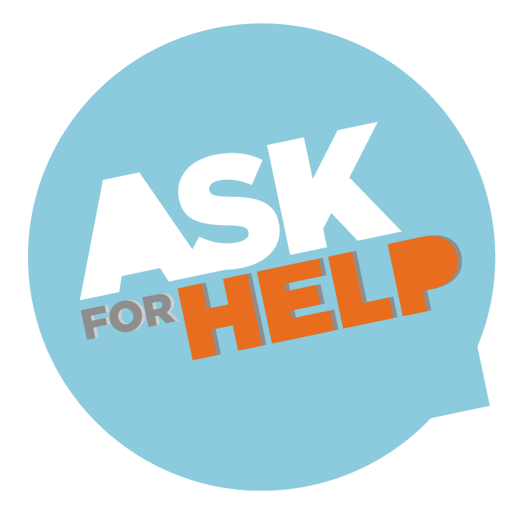
Tips For Talking With Children with I/DD
“A picture is worth a thousand words.”
Break information down into small steps
Repetition is helpful. Repetition is helpful.
Use as many resources as possible to teach the topic
See sexuality as a positive experience and make learning about it more fun
Reach out to others for help
Stay positive
Insert Text
Insert Text
Notes:
Using pictures of family or friends when describing various types of relationships will help make the concepts more realistic and relatable for your family member.
This is important to remember when teaching any aspect of sexuality, whether it be washing the pubic area or having other appropriate social interactions. We all learn best by learning small steps. You will also need to revisit many of the steps over and over again.
The brain is a marvelous thing. Different parts are responsible for processing differing media input such as spoken language, visual, touch, or music. Trying a variety of media formats will help you discover which one, or which combination, works best for your family member.
If you don’t know the answer find someone who does. There are professional organizations able to help. Even better, find another parent who has already gone through the process and ask them what they did. Even better, find another parent who has already gone through the process and ask them what they did.
We all need positive reinforcement when working on a task. Keep it positive and acknowledge a job well done. This will help your family member
59

Slide 60
Benefits of SRE for I/DD
Program evaluation utilizing both pre and post tests, finding that…
Youth displayed increased understanding of concepts (e.g. boundaries, safety, relationships)
Caregivers reported increased comfort and effectiveness in communication regarding sex/sexuality
Limitations
Cost
Time and Effort Intensive
Generalizing concepts taught to real world situations
Notes:
Morgan

Slide 61
101 Renee Lynne Court, Carrboro, NC 27510
919-966-5171
University of North Carolina at Chapel Hill
Campus Box #7255, Chapel Hill, NC 27599-7255
www.cidd.unc.edu
Margaret.DeRamus@cidd.unc.edu
Morgan.Parlier@cidd.unc.edu
Deborah.Zuver@cidd.unc.edu

Slide 62

Resources
ON-LINE VIRTUAL COURSE
Talking with Your Kids: Sexuality and Developmental Disabilities. Katherine McLaughlin, 2017 www.disabilityworkshops.com
WEBSITES
Elevatus Training: www.elevatustraining.com
Healthy Bodies: vkc.mc.vanderbilt.edu/healthybodies/
OAR Sex Ed for Self-Advocates: https://researchautism.org/sex-ed-guide/
SEICUS: https://siecus.org/resources/the-guidelines/
Sexuality Resource Center for Parents: www.srcp.org
Planned Parenthood: www.plannedparenthood.org
Advocates for Youth: www.advocatesforyouth.org

Slide 63
Resources
BOOKS
Teaching Children with Down Syndrome about Their Bodies, Boundaries, and Sexuality. Terri Couwenhoven. Woodbine House. 2007
The Boy’s Guide to Growing Up: Choices and Changes During Puberty. Terri Couwenhoven. Woodbine House. 2012
The Girl’s Guide to Growing up: Choices and Changes During the Tween Years. Terri Couwenhoven. Woodbine House. 2012
I Openers: Parents Ask Questions About Sexuality and Children with Developmental Disabilities. Dave Hingsburger. Family Support Institute Press. 1993

Slide 64
Resources
BOOKS
Sexuality: Your Sons and Daughters with Intellectual Disabilities. Karen Melberg Schwier and David Hingsburger.
Just Say Know: Understanding and Reducing the Risk of Sexual Victimization of People with Developmental Disabilities. Dave Hingsburger. Diverse city Press, Inc. 1995
It’s So Amazing. Robie Harris, Candlewick Press, 1999
It’s Perfectly Normal. Robie Harris, Candlewick press, 1994
Changing Bodies, Changing Lives. Ruth Bell, Three Rivers Press, 1998

Slide 65
References
Alberta Health Services. (2016). Sexuality and disability: A guide for parents. Retrieved from www.teachingsexualhealth.ca
Ballan, M. S., & Freyer, M. B. (2017). The sexuality of young women with intellectual and developmental disabilities: A neglected focus in the American foster care system. Disability and health journal, 10(3), 371- 375. doi: 10.1016/j.dhjo.2017.02.005
Baxley, D., & Zendell, A. (2005). Sexuality across the lifespan for children and adolescents with developmental disabilities. United States Department of Health and Human Services Administration on Developmental Disabilities and Florida Developmental Disabilities Council, Inc. Retrieved from https://www.uab.edu/civitansparks/images/Sex_Lifespan_Prt._1.pdf
Brown, K. R., Peña, E. V., & Rankin, S. (2017). Unwanted sexual contact: students with autism and other disabilities at greater risk. Journal of College Student Development, 58(5), 771-776. doi: 10.1353/csd.2017.0059
Friedman, C., Owen, A.L. (2017). Sexual health in the community: Services for people with intellectual and developmental
disabilities. Disability and health journal, 10(3), 387-393. doi: 10.1016/j.dhjo.2017.02.008
Hickson, L., Khemka, I., Golden, H., & Chatzistyli, A. (2015). Randomized controlled trial to evaluate an abuse prevention
curriculum for women and men with intellectual and developmental disabilities. American journal on intellectual and
developmental disabilities, 120(6), 490-503. doi: 10.1352/1944-7558-120.6.490
Hickson, L., Khemka, I., Golden, H., & Chatzistyli, A. (2013). Views and values of developmental disabilities and domestic
violence/sexual assault support professionals regarding the prevention and handling of situations of abuse. Journal of policy and practice in intellectual disabilities, 10(3), 207-214. doi: 10.1111/jppi.12040
McCann, E., Lee, R., & Brown, M. (2016). The experiences and support needs of people with intellectual disabilities who identify as LGBT: A review of the literature. Research in developmental disabilities, 57, 39- 53. doi: 10.1016/j.ridd.2016.06.013
Mahoney, A. & Poling, A. (2011). Sexual abuse prevention for people with severe developmental disabilities. Journal of
developmental and physical disabilities, 23(4), 369-376. doi: 10.1007/s10882-011-9244-2
National Sexual Violence Resource Center (NSVRC). (2019). Get statistics. Retrieved from https://www.nsvrc.org/statistics
Notes:
1. Using pictures of
family or friends when describing various types of relationships will help make the concepts more
realistic and relatable for your family member.
2. This is important to remember when teaching any aspect of sexuality, whether it be washing the pubic area or having other appropriate social interactions. We all learn best by learning small steps. You will also need to revisit many of the steps over and over again.
3. The brain is a marvelous thing. Different parts
are responsible for processing differing media input such as spoken language, visual, touch, or music.
Trying a variety of media formats will help you discover which one, or which combination, works best
for your family member.
If you don’t know the answer find someone who does. There are
professional organizations able to help. Even better, find another parent who has already gone through
the process and ask them what they did.
4. We all need positive reinforcement when working on a task. Throughout the manual you are
encouraged to keep it positive and acknowledge a job well done. This will help your family member
5. If you don’t know the answer find someone who does. There are professional organizations able to help.
Even better, find another parent who has already gone through
the process and ask them what they did.

Slide 66
References
Planned Parenthood. (2019). Tips for talking. - How do I talk to my child about sexual and reproductive health? Retrieved from
https://www.plannedparenthood.org/learn/parents/tips-talking
Rape, Abuse & Incest National Network (RAINN). (2019). Scope of the problem: Statistics. Retrieved from https://www.rainn.org/statistics
Resource Center for Adolescent Pregnancy Prevention. (2019). Skills for educators: Sharing values about sexuality. Retrieved
from http://recapp.etr.org/Recapp/index.cfm?fuseaction=pages.EducatorSkillsDetail&PageID=95
Starford, M., Jones, C., & Davis, L.A. (2017). Talk about sexual violence – final report. Board Resource Center (BRC) & The Arc’s National Center on Criminal Justice and Disability (NCCJD). Retrieved from https://www.thearc.org/file/nccjd_sexual-violence/ARC-BRC-finalreport-6-FINAL.pdf
Ward, K. M., Atkinson, J. P., Smith, C. A., & Windsor, R. (2013). A friendships and dating program for adults with intellectual and
developmental disabilities: A formative evaluation. Intellectual and developmental disabilities, 51(1), 22-32.
doi: 10.1352/1934-9556-51.01.022
Weitlauf, A., et al. (2013). Healthy bodies: A parent’s guide on puberty for boys with disabilities. Vanderbilt Kennedy Center Consortium
Leadership in Education and Neuordevelopmental Disabilities. Retrieved from
https://vkc.mc.vanderbilt.edu/healthybodies/files/HealthyBodies-Boys-web.pdf
Weitlauf, A., et al. (2013). Healthy bodies: A parent’s guide on puberty for girls with disabilities. Vanderbilt Kennedy Center Consortium
Leadership in Education and Neuordevelopmental Disabilities. Retrieved from https://vkc.mc.vanderbilt.edu/healthybodies/girls.html
Weitlauf, A., et al. (2013). Healthy bodies for boys - Appendix. Vanderbilt Kennedy Center Consortium Leadership in Education and Neuordevelopmental Disabilities. Retrieved from https://vkc.mc.vanderbilt.edu/healthybodies/files/HealthyBodiesAppendix-Boys.pdf
Weitlauf, A., et al. (2013). Healthy bodies for girls - Appendix. Vanderbilt Kennedy Center Consortium Leadership in Education and Neuordevelopmental Disabilities. Retrieved from https://vkc.mc.vanderbilt.edu/healthybodies/files/HealthyBodiesAppendix-Girls.pdf
Notes:
1. Using pictures of
family or friends when describing various types of relationships will help make the concepts more
realistic and relatable for your family member.
2. This is important to remember when teaching any aspect of sexuality, whether it be washing the pubic area or having other appropriate social interactions. We all learn best by learning small steps. You will also need to revisit many of the steps over and over again.
3. The brain is a marvelous thing. Different parts
are responsible for processing differing media input such as spoken language, visual, touch, or music.
Trying a variety of media formats will help you discover which one, or which combination, works best
for your family member.
If you don’t know the answer find someone who does. There are
professional organizations able to help. Even better, find another parent who has already gone through
the process and ask them what they did.
4. We all need positive reinforcement when working on a task. Throughout the manual you are
encouraged to keep it positive and acknowledge a job well done. This will help your family member
5. If you don’t know the answer find someone who does. There are professional organizations able to help.
Even better, find another parent who has already gone through
the process and ask them what they did.

Slide 67




Challenging Subject Matter
Notes:
Morgan
The media provides a great deal of the messages we receive regarding sexuality, and the messages often convey that sex is for the young and beautiful and based on lack of representation of individuals with developmental disabilities, reserved for the typically developing

Slide 68

Notes:
Morgan
I want to give you a moment to think about the messages you received when you were growing up about sexuality. Consider how your family expressed affection, what gender roles were modeled, what topics were discussed as you developed, and what topics weren’t? Where did you get information about puberty, dating, and sex?
Did anyone teach you about sexual pleasure?
Now, if you feel comfortable, raise your hand if the messages you received were predominantly positive/negative/neutral

Slide 69
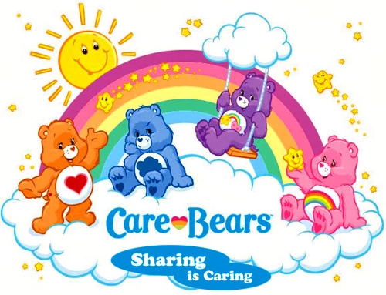
Notes:
Morgan
Now, if you feel comfortable, raise your hand if the messages you received were predominantly positive/negative/neutral

